Slide 1
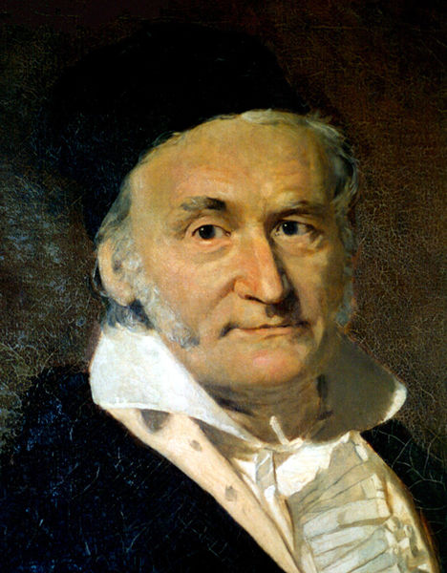
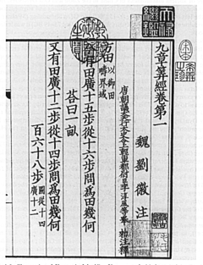
Solving Sets of Equations
150 B.C.E., 九章算術
Carl Friedrich Gauss, 1777-1855

Slide 2
LU Factorization with Partial Pivoting
With partial pivoting, each M_{k} is preceded by permutation P_{k} to interchange rows to bring entry of largest magnitude into diagonal pivot position
Still obtain MA = U, with U upper triangular, but now M = M_{n-1}P_{n-1}···M₁P₁
L=M⁻¹ is not a triangular due to permutations

Slide 3
Example: Pivoting

Slide 4
Example: Pivoting (cont.)

Slide 5
Example: Pivoting (cont.)
U is still upper triangular but
L is not lower triangular due to permutations

Slide 6
Complete Pivoting
Complete pivoting is a more exhaustive strategy in which the largest entry in the entire remaining unreduced submatrix is permuted into the diagonal pivot position
Requires interchanging columns as well as rows leading to factorization PAQ = LU with L unit lower triangular, U upper triangular, and P, Q permutations
Notes:
Decompose PAQ as LU. This doesn’t mean that A is decomposed as LU!
LU is the decomposition of PAQ, not A!

Slide 7
Complete Pivoting (cont.)
Numerical stability of complete pivoting is theoretically superior, but pivot search is more expensive than for partial pivoting
Numerical stability of partial pivoting is more adequate in practice, so it is almost always used in solving linear system by Gaussian elimination

Slide 8
Scaling Linear Systems
In principle, the solution to a linear system is unaffected by diagonal scaling of matrix and right-hand-side vector
Example: row scaling premultiplying both sides of system by a nonsingular diagonal matrix D, the solution is unchanged

Slide 9
Scaling Linear Systems (cont.)
In practice, scaling affects both conditioning of a matrix and selection of pivots in Gaussian elimination, which in turn affect numerical accuracy in finite-precision arithmetic
It is usually best if all entries of the matrix have about the same size (magnitude)

Slide 10
Scaling Linear Systems (cont.)
Sometimes it may be easy to accomplish this by choosing measurement units for variables, but there is no foolproof method for doing so in general
Scaling can introduce error if not done carefully!

Slide 11
Example: Scale Partial Pivoting
Given the exact solution is x = [1, 1, 1]^{T}
If only 3 digits of precision is used we obtain an erroneous solution x = [0.939, 1.09, 1.00]^{T}

Slide 12
Example: Scale Partial Pivoting (cont.)
Premultiplying by a scaling matrix
Pivoting is required at the first column!

Slide 13
Example: Scale Partial Pivoting (cont.)
In algorithm implementation, we don’t scale equations explicitly
Instead, we store the scale vector and row interchange information and only use them for pivot selection
partial pivoting
no pivoting is required

Slide 14
Complexity of Solving Linear System
LU factorization requires about n³/3 floating-point multiplications and similar number of additions
Forward and back substitution for single right-hand side vector together require about n² multiplications and similar number of additions

Slide 15
Compute Inverse by Solving Linear System
Solve Ax = I
Computing A⁻¹ is equivalent to solve n linear systems, requiring LU factorization of A followed by n forward and backward substitutions, one for each column of identity matrix
Operation count for inversion is about n³, three times expensive as LU factorization

Slide 16
Inversion vs. Factorization
x=A⁻¹b
Needs to solve Ax = I
LU factorization
n forward and backward substitutions
Multiplication of matrix and vector
LUx = b
LU factorization
One forward and backward substitution

Slide 17
Inversion vs. Factorization (cont.)
Inversion gives a less accuracy answer; e.g., solving 3x = 18 by division gives x = 18/3 = 6, but inversion gives x = 3⁻¹ × 18 = 0.333 × 18 = 5.99 (using 3-digit arithmetic)

Slide 18
Inversion vs. Factorization (cont.)
Matrix inverse often occurs as convenient notation in formulas, but explicit inverse is rarely required to implement such formulas
For example, product A⁻¹B should be computed by LU factorization of A, followed by forward and backward substitution using each column of B
Use factorization instead of inversion

